Slide 1

Spam Detection using NLP
Under the guidance of Dr. Maninder Singh
Presented by: Team #2
Deepika Kakkera
Divya Darsi
Jyoshika Sripathi
Karthik Kommera

Slide 2
INTRODUCTION
To develop a spam detection model for devices to reduce inbox clutter caused by unwanted emails, commonly known as spam.
By collecting message data and applying natural language processing techniques, we'll classify messages as either spam or ham.
This model will enhance inbox visualization, marking unnecessary messages as spam to save users time.
Our approach offers an efficient solution to manage inbox overload, providing users with a cleaner and more organized inbox experience.
Through devised spam detection, we aim to streamline email management on devices.

Slide 3
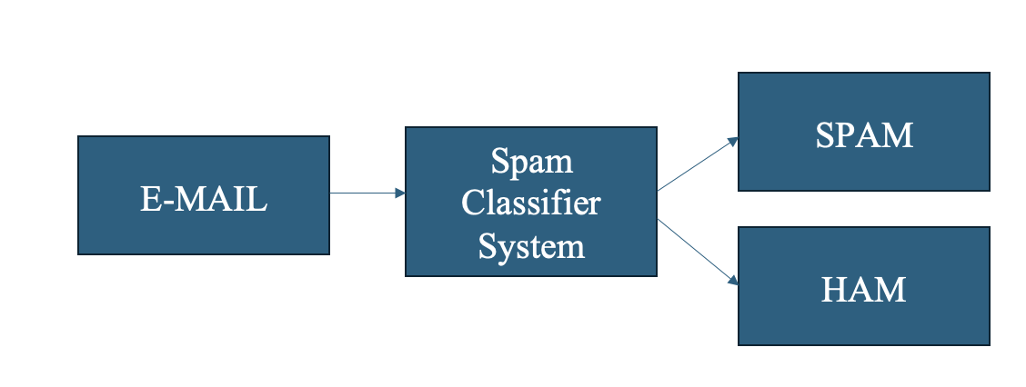

Slide 4
PROBLEM STATEMENT
With the increasing use of mobile devices and digital communication platforms, the volume of spam messages has grown significantly.
These unwanted messages can range from simple advertisements to more malicious content, such as phishing attempts or fraudulent schemes. Protecting users from fraudulent messages that could lead to financial loss or identity theft.
Enhancing the user experience by reducing the clutter of unwanted messages. Preserving the integrity and reliability of communication medium

Slide 5

MOTIVATION
In today's interconnected world, spam detection is crucial to protect users from scams.
To overcome this problem, we are working on spam-detection which uses Multinomial NAIVE-BAYES Theorem, BOW, TF_IDF, Stemming, POS, etc...
The outlined approach leverages natural language processing to build an effective spam filter, enabling real-time classification of incoming messages as spam or legitimate, thus enhancing user experience and security.

Slide 6

EXPERIMENT DESIGN
RQ:
Which feature extraction method, TF-IDF or Bag-of-Words (BOW), yields higher accuracy in classifying emails as spam or ham when employed with a Multinomial Naive Bayes algorithm?

Slide 7
DATA COLLECTION METHODS
Our project utilizes a dataset of over 10,000 emails to train a machine learning model for spam classification. This data comes from two sources:
Kaggle Repository: We obtained a dataset containing 5,000 emails categorized as "Spam" or "Ham" (solicited vs. unsolicited).
Online Sources: An additional 5,000 emails were collected from various online resources.

Slide 8
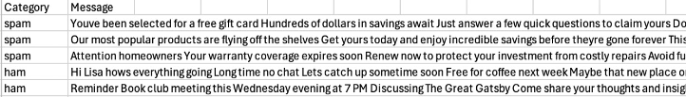
DATA SET
The training dataset, split into 80% for model training and 20% for evaluation, contains labeled emails categorized as "Spam" or "Ham." It serves to teach the model key features distinguishing between legitimate and spam emails, facilitating effective classification.

Slide 9
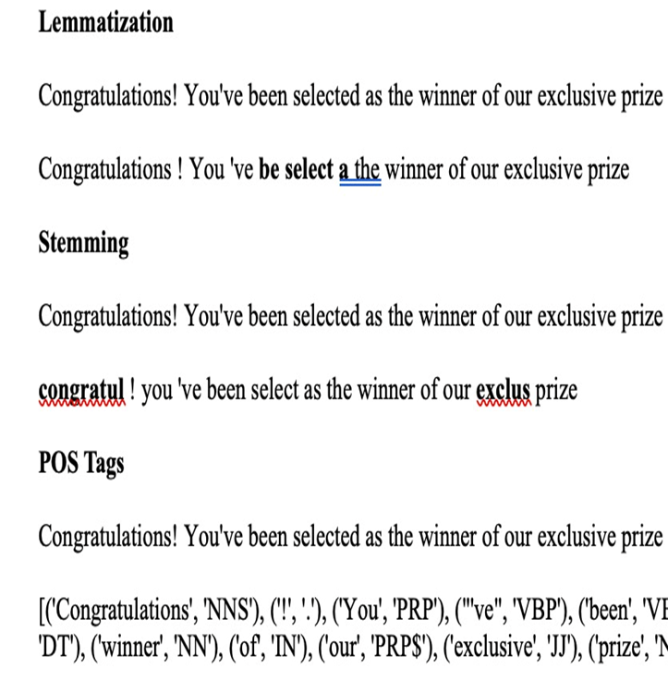
DATA PRE-PROCESSING METHODS
Our system incorporates Lemmatization and Stemming to standardize word forms by reducing them to their base or root forms, thereby simplifying subsequent analysis.
Additionally, we utilize Part-of-Speech (POS) Tagging to assign syntactic categories to words, aiding in understanding the grammatical structure of the text.

Slide 10
SELECTED EVALUATION METRICS
In the email spam detection experiment, the success of the classifier will be evaluated using the following evaluation metrics:
1. Accuracy
2. Precision
3. Recall
4. F1 Score

Slide 11
EXPERIMENT PROCEDURE
1. Import Libraries
2. Load and Preprocess Data
3. Text Preprocessing Functions
4.Split Data
5. Feature Extraction
6. Define and Train Classifiers
7. K-fold Cross-Validation
8. Model Performance Comparison
9. Handling Imbalanced Data using SMOTE

Slide 12

Demo

Slide 13
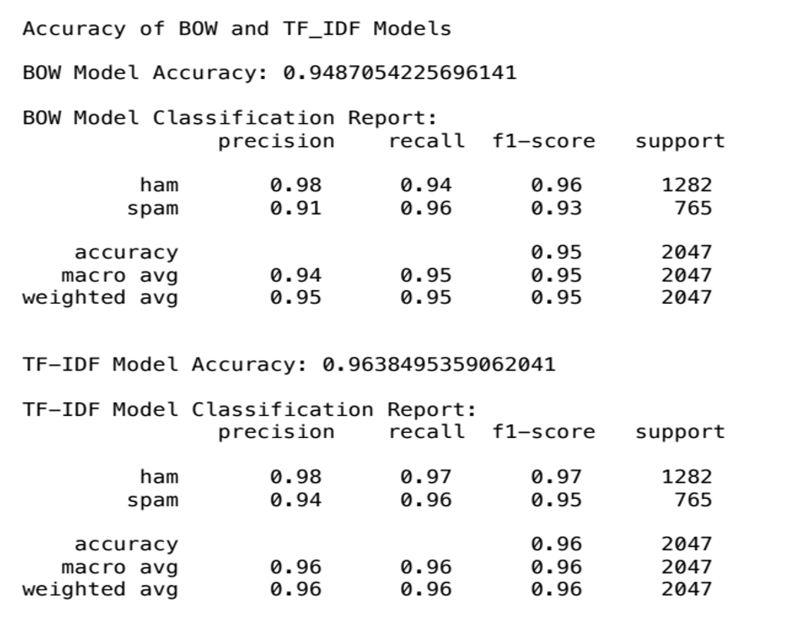
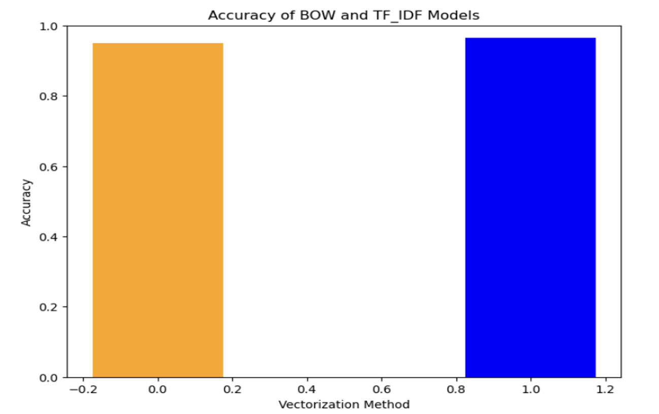
RESULTS AND DISCUSSIONS
The results obtained from our experiment aim to answer the research question.

Slide 14
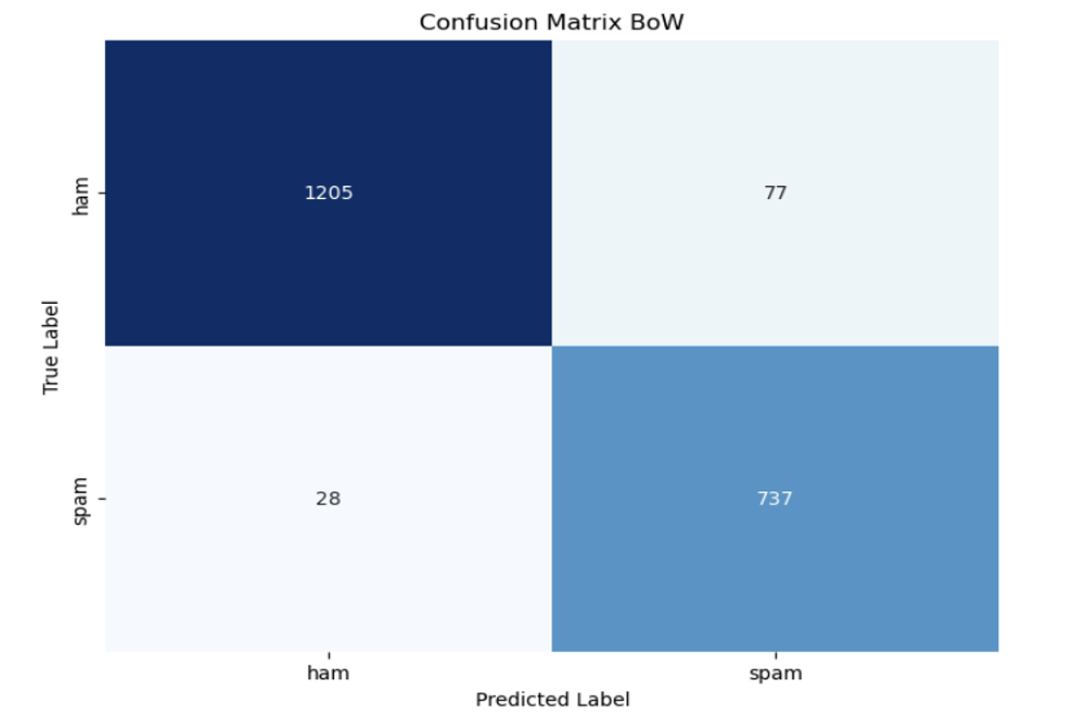
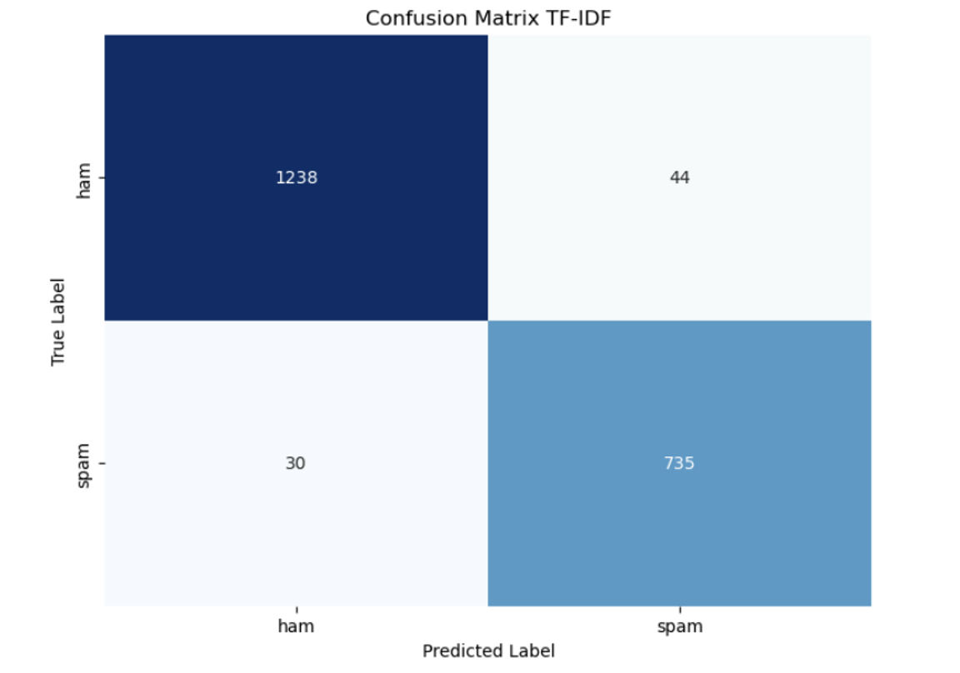

Slide 15
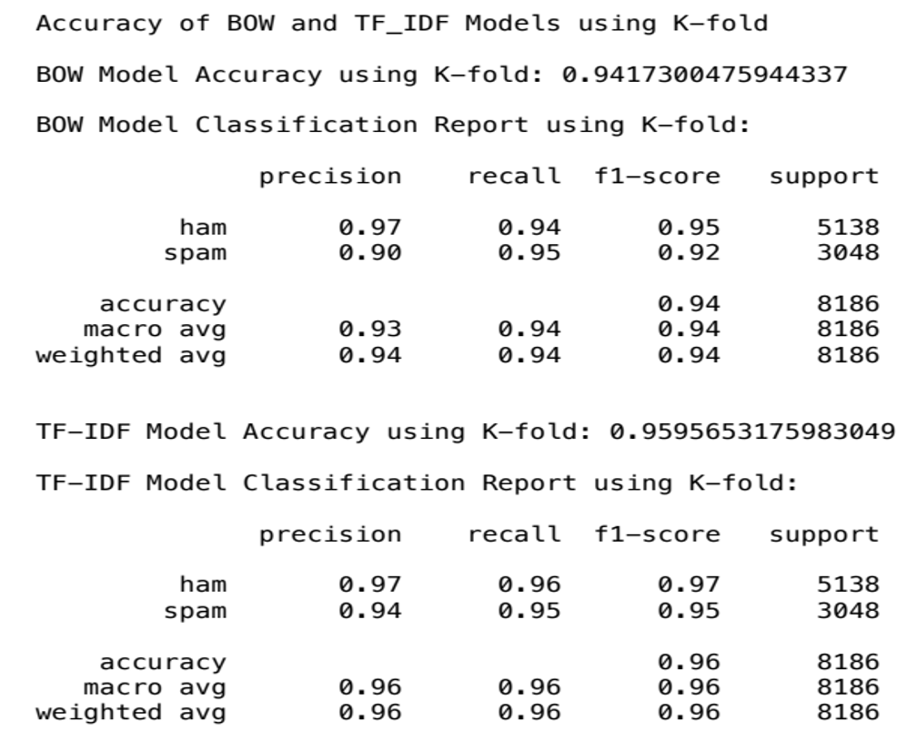
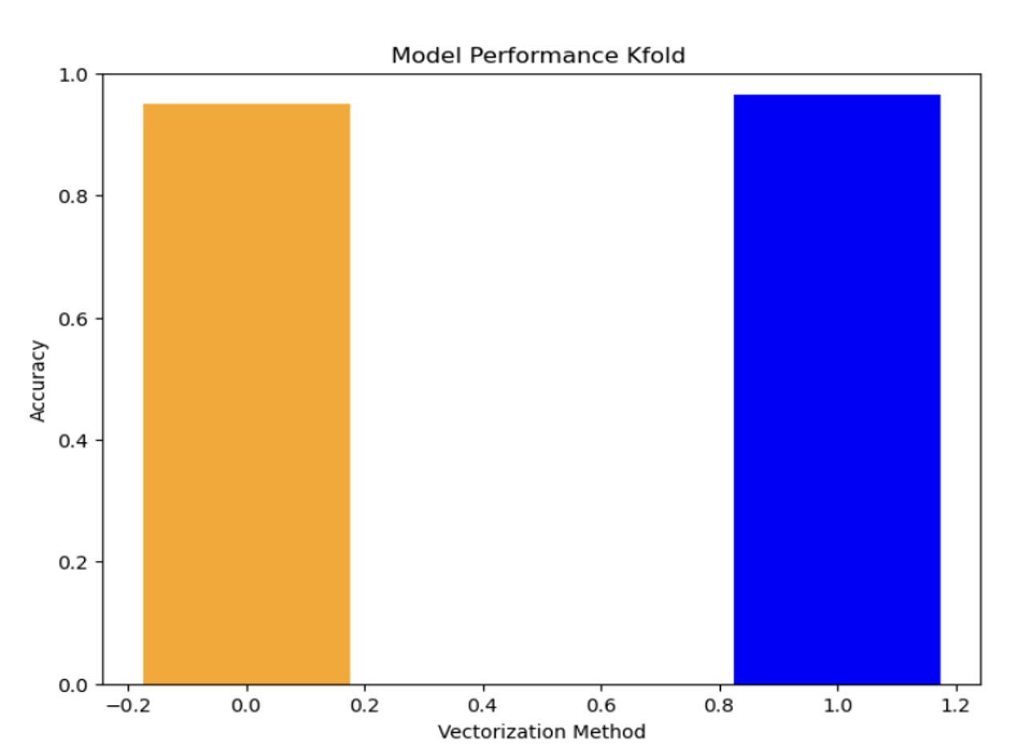
ACCURACY OF BOW AND TF_IDF MODELS USING K-FOLD

Slide 16
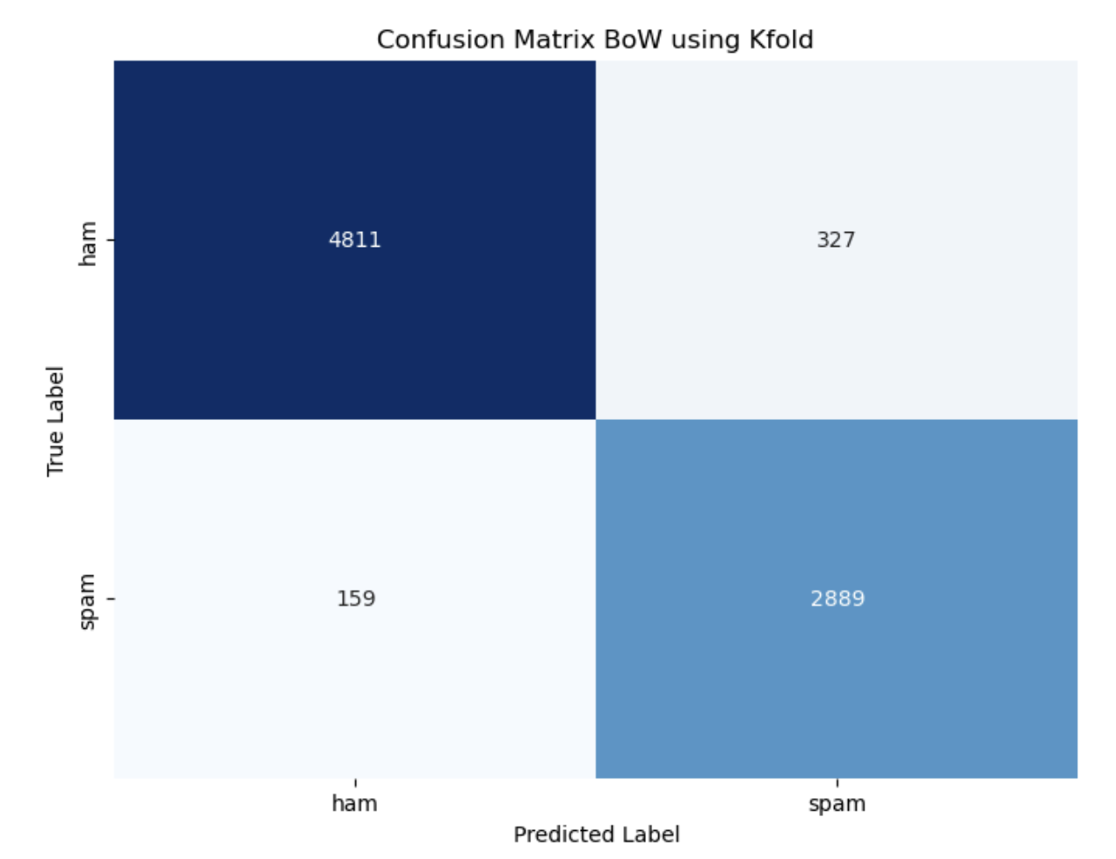
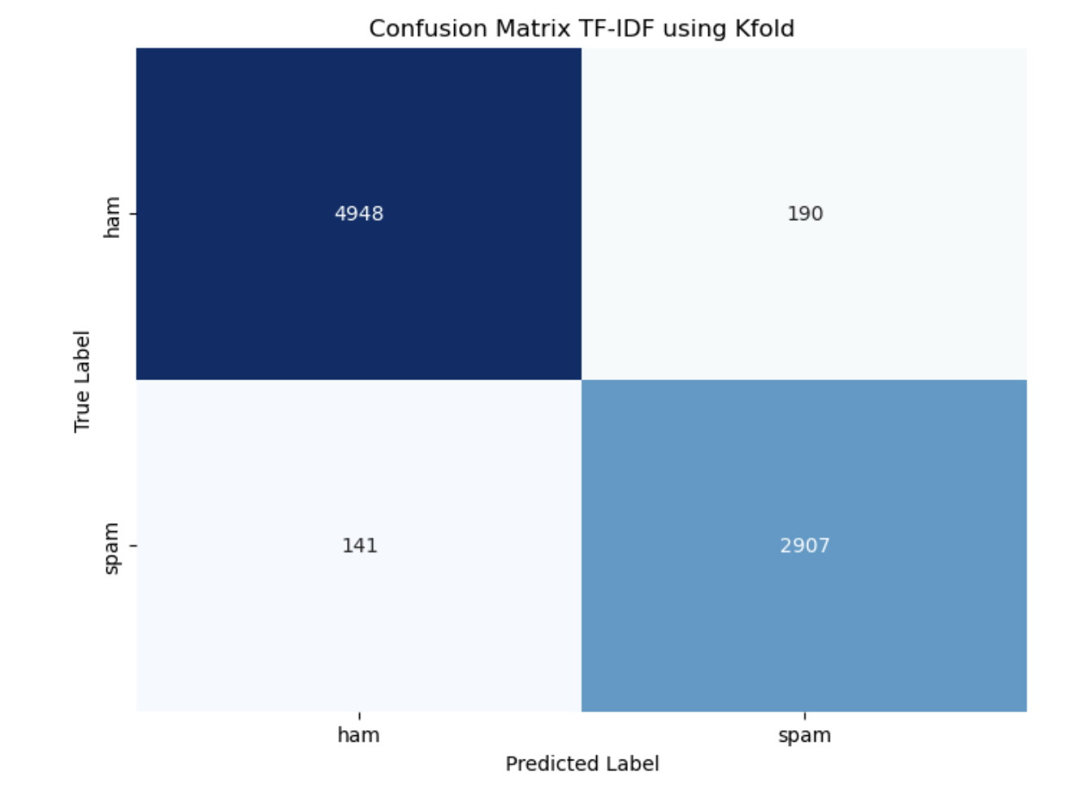

Slide 17
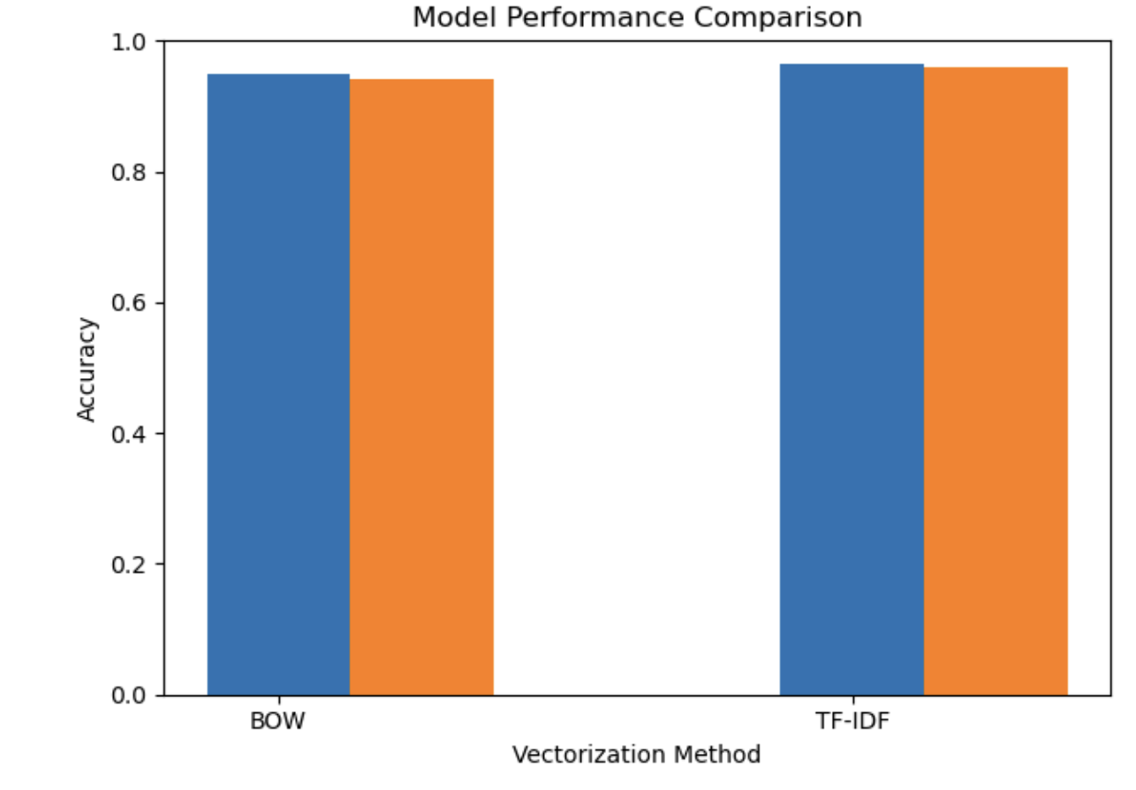
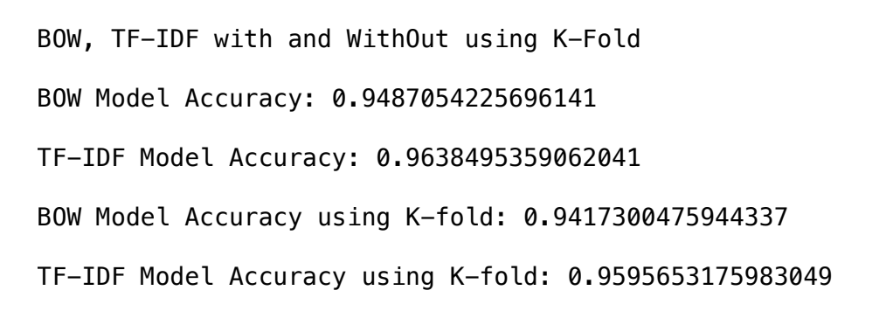

Slide 18
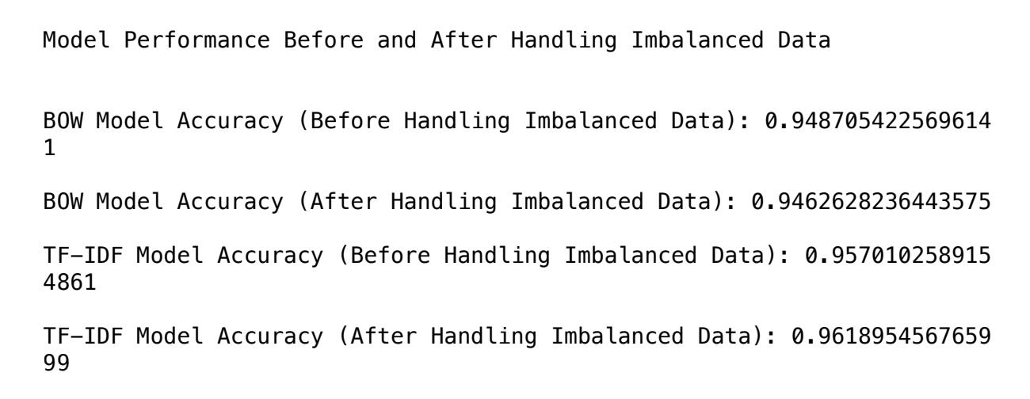
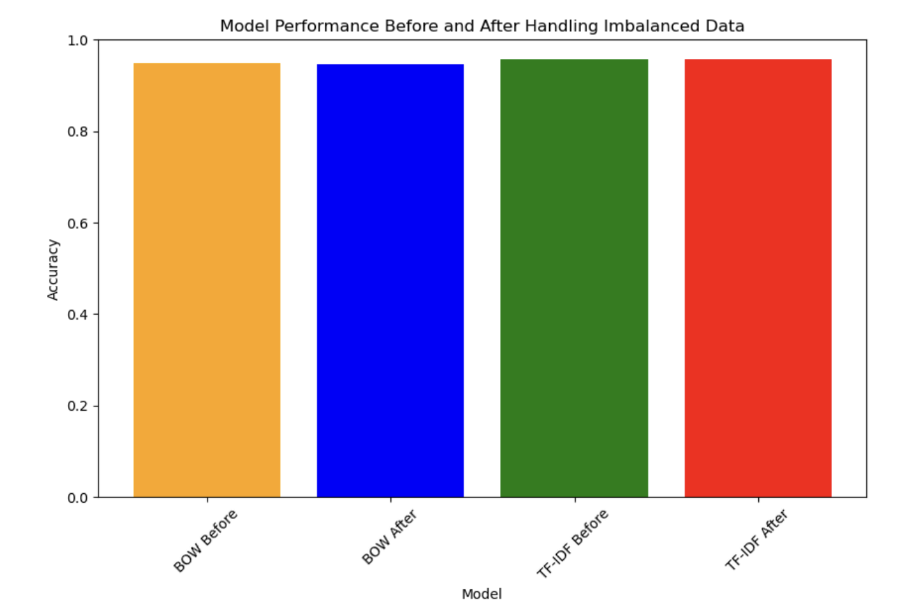

Slide 19
CONCLUSIONS AND FUTURE SCOPE
In this project, we explored the effectiveness of Bag-of-Words (BOW) and Term Frequency-Inverse Document Frequency (TF-IDF) methods with Multinomial Naive Bayes for email classification.
TF-IDF outperformed BOW, indicating its superiority in distinguishing spam from legitimate emails. Preprocessing and handling class imbalance further improved performance.
Future scope includes exploring advanced text representations, ensemble methods, domain-specific features, adapting to evolving spam tactics, and integrating user feedback mechanisms for continual model refinement and enhanced user experience.

Slide 20
Task assignments among team members
Name | Contributions
Divya Darsi | Introduction, Proposed Solution, Research Question, Programming/Execution, Hardware/software descriptions, Experimental Design, Experimental procedure, Result and Discussion, Conclusion, Documentation & Presentation.
Deepika Kakkera | Problem Statement, Motivation, Data Set, Preprocessing Data, Experimental Design, Experimental procedure, Result and Discussion, Conclusion, Documentation & Presentation
Jyoshika Sripathi | Proposed Solution, Major Functionalities, Research Question , Experiment Design, Describe pre-processing of your Dataset, Experimental Design, Experimental procedure, Result and Discussion, Conclusion, Documentation & Presentation.
Karthik Kommera | Background, Project Risks, Data Set, Experiment Validation, Approach refinement, Experimental Design, Experimental procedure, Result and Discussion, Conclusion, Documentation & Presentation.

Slide 21

References
https://machinelearningmastery.com/k-fold-cross-validation/
https://www.kdnuggets.com/2022/07/kfold-cross-validation.html
https://scikit-learn.org/stable/modules/generated/sklearn.naive_bayes.MultinomialNB.html#:~:text=The%20multinomial%20Naive%20Bayes%20classifier,tf%2Didf%20may%20also%20work.
https://www.upgrad.com/blog/multinomial-naive-bayes-explained/
https://www.geeksforgeeks.org/multinomial-naive-bayes/
https://towardsdatascience.com/multinomial-na%C3%AFve-bayes-for-documents-classification-and-natural-language-processing-nlp-e08cc848ce6
https://www.analyticsvidhya.com/blog/2020/10/overcoming-class-imbalance-using-smote-techniques/

Slide 22

Q & A
THANK YOU

